Slide 1

Introduction to Symmetry!

Slide 2

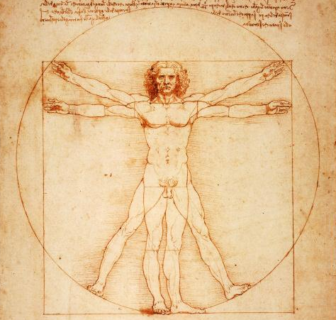
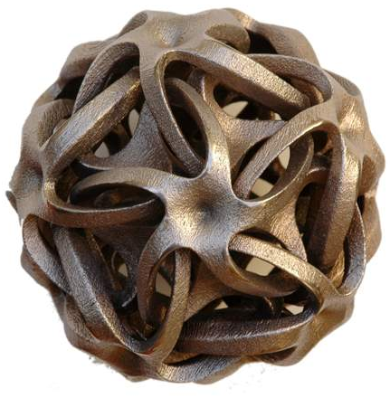


Symmetry is everywhere…
An icosahedral HIV virus
Vitruvian Man by Leonardo Da Vinci
..but what does “symmetry” mean?

Slide 3
Main goal of this course: to understand
precisely what “symmetry” means and to
classify the ways in which 2- and 3-dimensional
objects can be symmetric.

Slide 4

QUIZ: Rank these 2-dimensional objects
from the most to the least symmetric.
(Our first challenge will be to make this question more precise.)

Slide 5
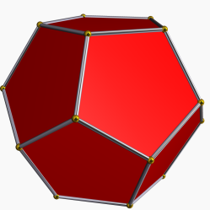
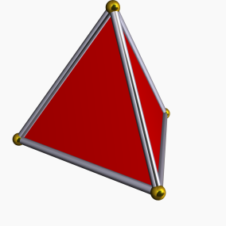
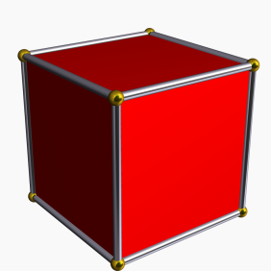
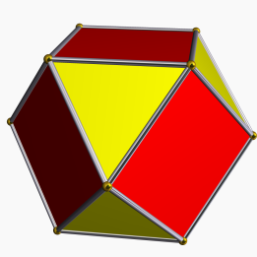
LATER IN THE COURSE: We’ll do the same
for 3-dimensional object. How would you
rank these objects?

Slide 6
Ch. 1: Introduction to Symmetry!

Slide 7
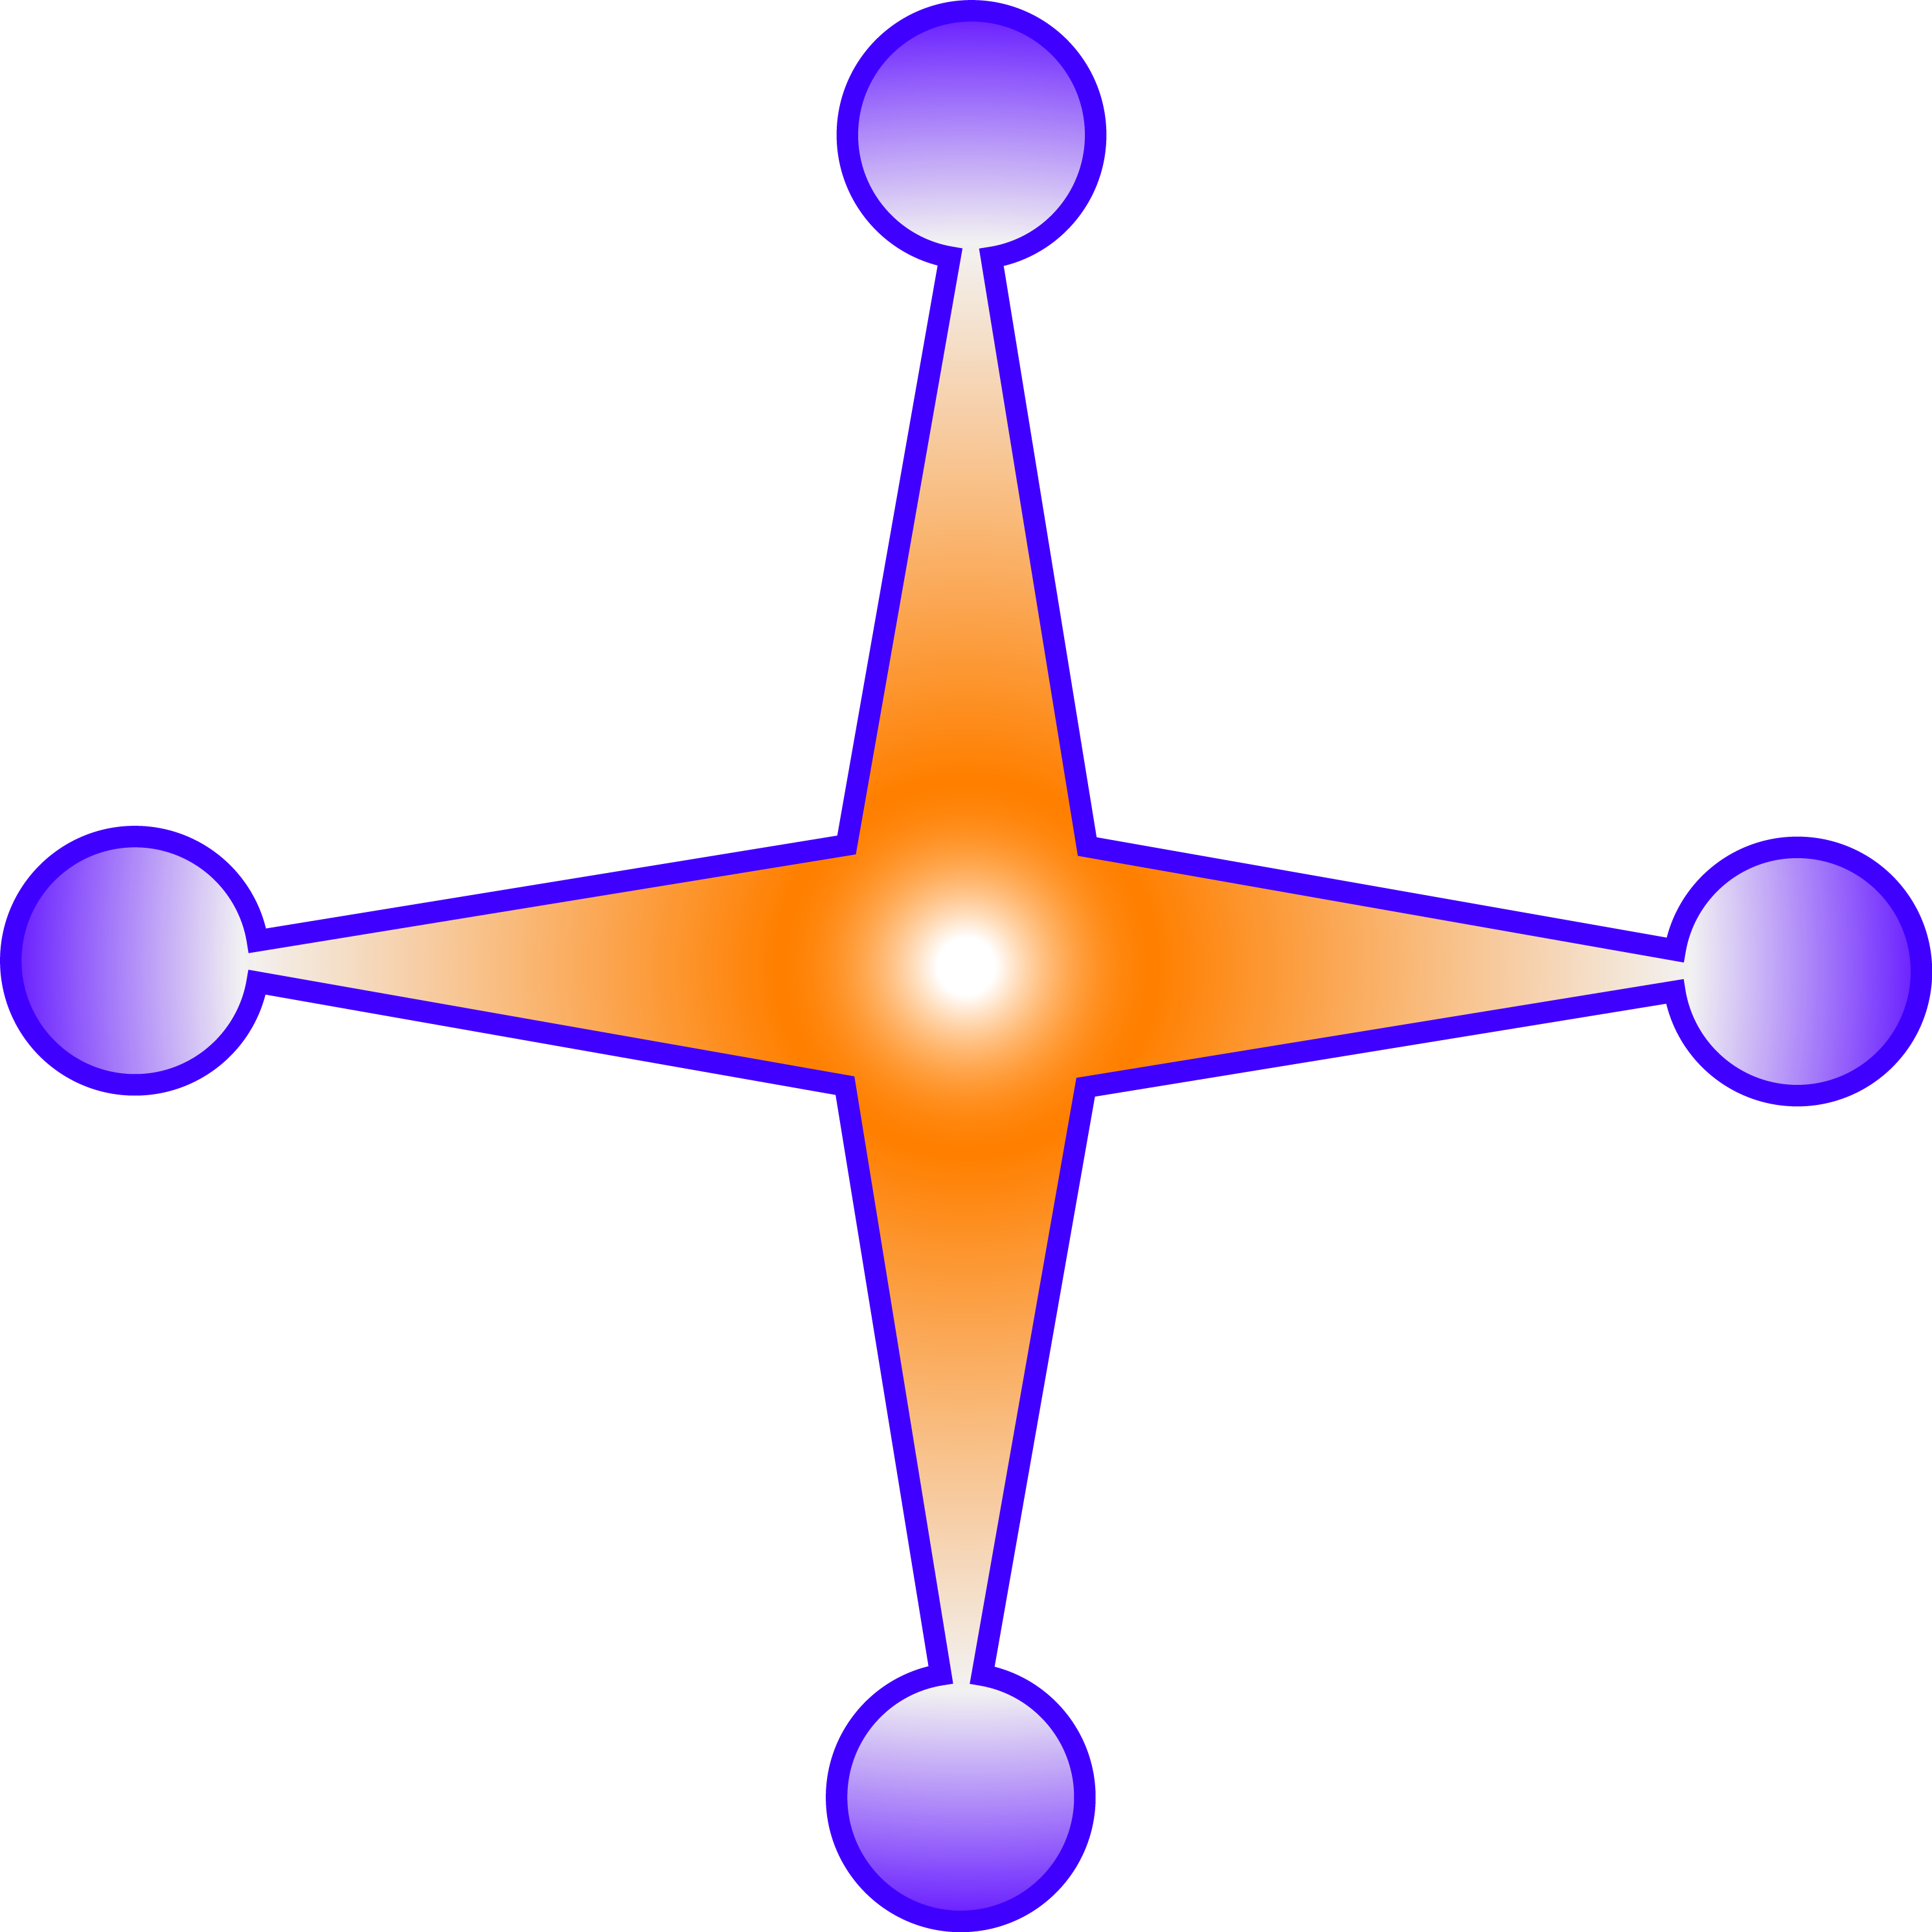
Intuitively, why does this star look symmetric?

Slide 8
Intuitively, why does this star look symmetric?
→ It looks the same from many positions

Slide 9
Intuitively, why does this star look symmetric?
→ It looks the same from many positions
→ It has repeated images/parts.

Slide 10
Intuitively, why does this star look symmetric?
→ It looks the same from many positions
→ It has repeated images/parts.
What is the underlying cause
of both observations?

Slide 11
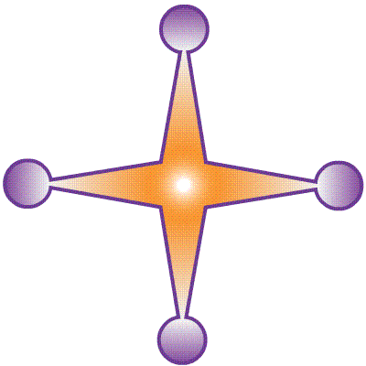
Intuitively, why does this star look symmetric?
→ It looks the same from many positions
→ It has repeated images/parts.
What is the underlying cause
of both observations?
Rotating the plane 90 degrees leaves the star apparently unchanged.

Slide 12
Intuitively, why does this star look symmetric?
→ It looks the same from many positions
→ It has repeated images/parts.
What is the underlying cause
of both observations?
Rotating the plane 90 degrees leaves the star apparently unchanged.
(this is the real reason that its 4 arms look the same)

Slide 13
Intuitively, why does this star look symmetric?
→ It looks the same from many positions
→ It has repeated images/parts.
What is the underlying cause
of both observations?
Rotating the plane 90 degrees leaves the star apparently unchanged.
This rotation is called a symmetry of the star.

Slide 14
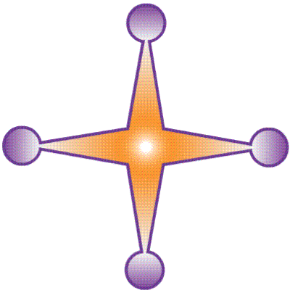
Intuitively, why does this star look symmetric?
→ It looks the same from many positions
→ It has repeated images/parts.
What is the underlying cause
of both observations?
Flipping the plane also leaves the star apparently unchanged.

Slide 15
Intuitively, why does this star look symmetric?
→ It looks the same from many positions
→ It has repeated images/parts.
What is the underlying cause
of both observations?
Flipping the plane also leaves the star apparently unchanged.
(this explains some of its repeated parts)

Slide 16
Intuitively, why does this star look symmetric?
→ It looks the same from many positions
→ It has repeated images/parts.
What is the underlying cause
of both observations?
Flipping the plane also leaves the star apparently unchanged.
This flip is also called a symmetry of the star.
(“reflection” is a synonym for “flip”)

Slide 17
Summary: This star looks symmetric
because certain rigid motions
of the plane (rotations & flips)
leave it apparently unchanged.

Slide 18
Summary: This star looks symmetric
because certain rigid motions
of the plane (rotations & flips)
leave it apparently unchanged.
DEFINITON: A symmetry of an object in the plane is a rigid motion of the plane that leaves the object apparently unchanged.
How many symmetries does the star have?

Slide 19
Summary: This star looks symmetric
because certain rigid motions
of the plane (rotations & flips)
leave it apparently unchanged.
DEFINITON: A symmetry of an object in the plane is a rigid motion of the plane that leaves the object apparently unchanged.
How many symmetries does the star have?
It has 4 rotations (about its center by 0, 90, 180, and 270 degrees).
Rotating by zero degree does nothing – it is called the identity rigid motion. By convention, the identity counts as a symmetry of any object.

Slide 20
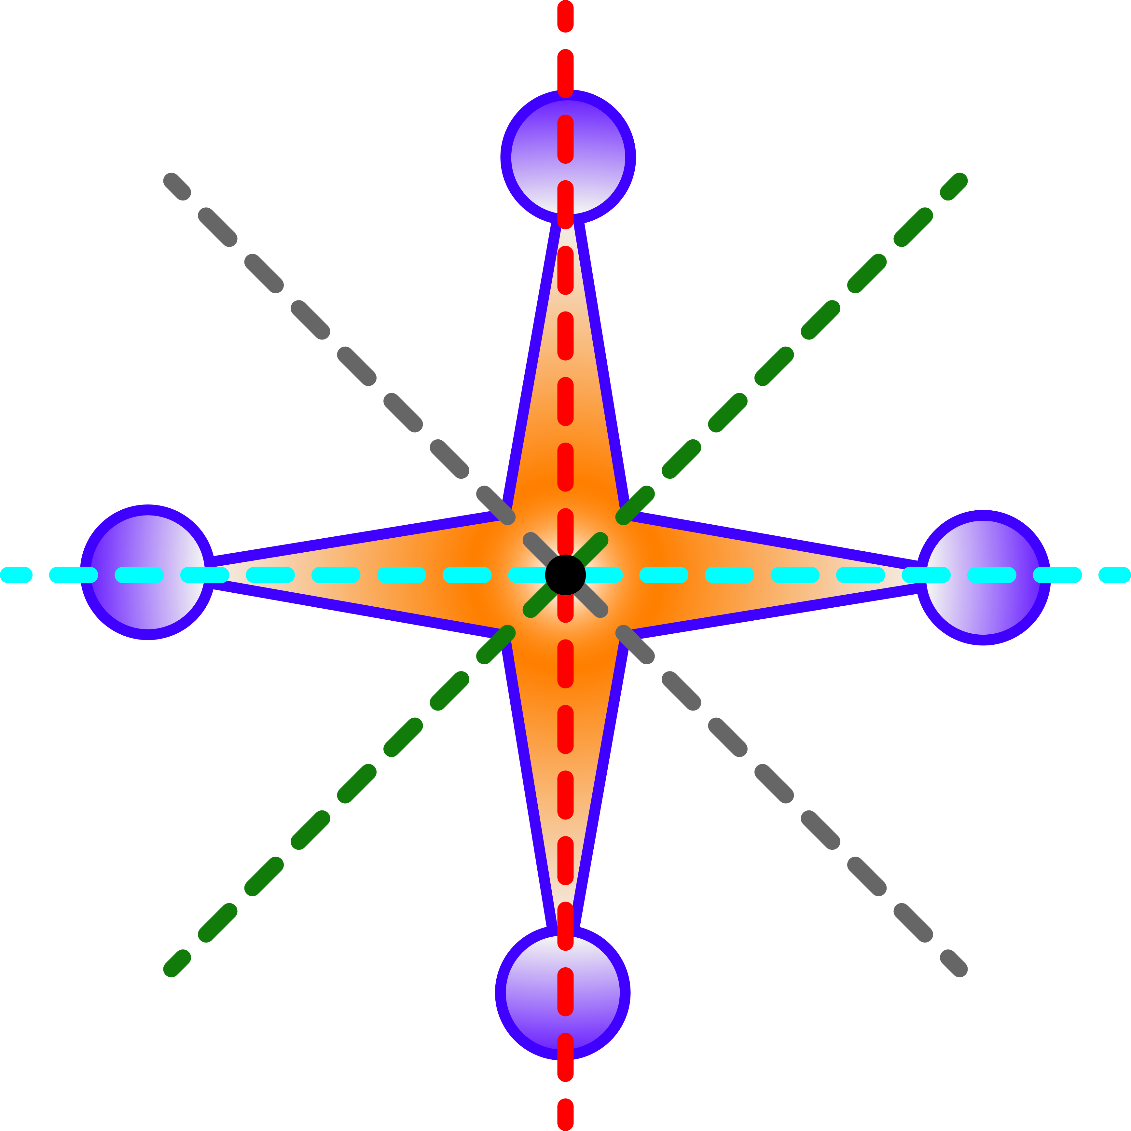
Summary: This star looks symmetric
because certain rigid motions
of the plane (rotations & flips)
leave it apparently unchanged.
DEFINITON: A symmetry of an object in the plane is a rigid motion of the plane that leaves the object apparently unchanged.
How many symmetries does the star have?
It has 4 rotations (about its center by 0, 90, 180, and 270 degrees)
It also has 4 flips.
TOTAL = 8 symmetries

Slide 21
How many rotation symmetries
does this object have?
How many reflection symmetries?
DEFINITON: A symmetry of an object in the plane is a rigid motion of the plane that leaves the object apparently unchanged.

Slide 22
How many rotation symmetries
does this object have?
How many reflection symmetries?
DEFINITON: A symmetry of an object in the plane is a rigid motion of the plane that leaves the object apparently unchanged.
4 rotations and 4 reflections

Slide 23
How many rotation symmetries
does this object have?
How many reflection symmetries?
DEFINITON: A symmetry of an object in the plane is a rigid motion of the plane that leaves the object apparently unchanged.

Slide 24
How many rotation symmetries
does this object have?
How many reflection symmetries?
DEFINITON: A symmetry of an object in the plane is a rigid motion of the plane that leaves the object apparently unchanged.
2 rotations and 2 reflections

Slide 25
How many rotation symmetries
does this object have?
How many reflection symmetries?
DEFINITON: A symmetry of an object in the plane is a rigid motion of the plane that leaves the object apparently unchanged.

Slide 26
How many rotation symmetries
does this object have?
How many reflection symmetries?
DEFINITON: A symmetry of an object in the plane is a rigid motion of the plane that leaves the object apparently unchanged.
3 rotations and 3 reflections

Slide 27
How many rotation symmetries
does this object have?
How many reflection symmetries?
DEFINITON: A symmetry of an object in the plane is a rigid motion of the plane that leaves the object apparently unchanged.

Slide 28
How many rotation symmetries
does this object have?
How many reflection symmetries?
DEFINITON: A symmetry of an object in the plane is a rigid motion of the plane that leaves the object apparently unchanged.
5 rotations and 5 reflections

Slide 29
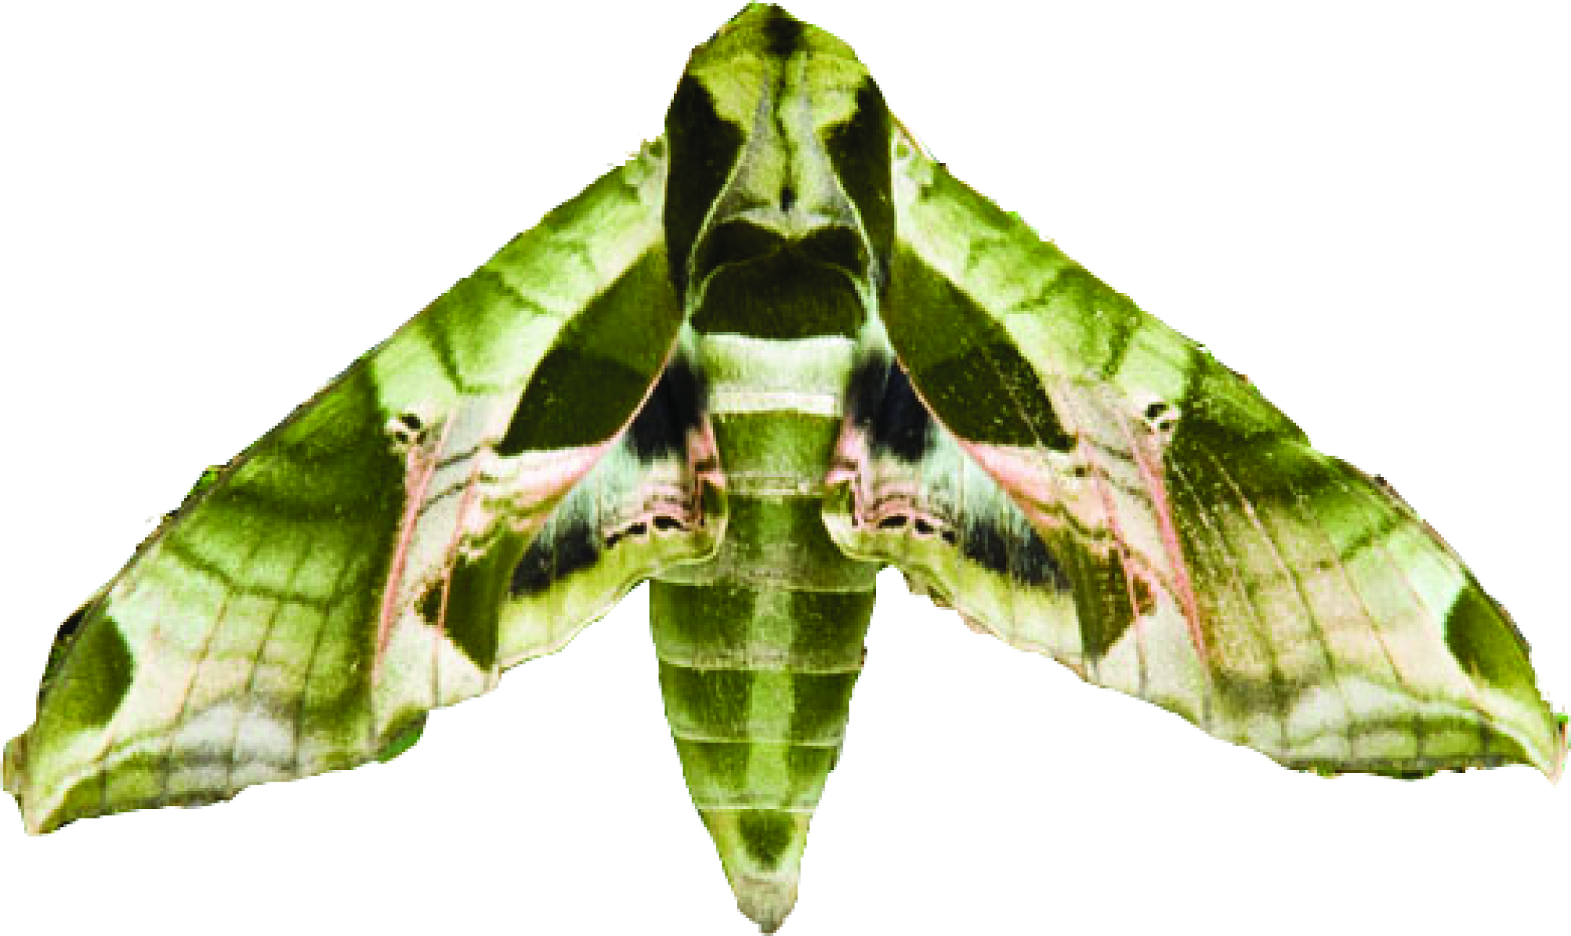
How many rotation symmetries
does this object have?
How many reflection symmetries?
DEFINITON: A symmetry of an object in the plane is a rigid motion of the plane that leaves the object apparently unchanged.

Slide 30
How many rotation symmetries
does this object have?
How many reflection symmetries?
DEFINITON: A symmetry of an object in the plane is a rigid motion of the plane that leaves the object apparently unchanged.
1 rotation and 1 reflection

Slide 31

How many rotation symmetries
does this object have?
How many reflection symmetries?
DEFINITON: A symmetry of an object in the plane is a rigid motion of the plane that leaves the object apparently unchanged.

Slide 32
How many rotation symmetries
does this object have?
How many reflection symmetries?
DEFINITON: A symmetry of an object in the plane is a rigid motion of the plane that leaves the object apparently unchanged.
1 rotation and 1 reflection

Slide 33

How many rotation symmetries
does this object have?
How many reflection symmetries?
DEFINITON: A symmetry of an object in the plane is a rigid motion of the plane that leaves the object apparently unchanged.

Slide 34
How many rotation symmetries
does this object have?
How many reflection symmetries?
DEFINITON: A symmetry of an object in the plane is a rigid motion of the plane that leaves the object apparently unchanged.
5 rotations and 0 reflections

Slide 35

How many rotation symmetries
does this object have?
How many reflection symmetries?
DEFINITON: A symmetry of an object in the plane is a rigid motion of the plane that leaves the object apparently unchanged.

Slide 36
How many rotation symmetries
does this object have?
How many reflection symmetries?
DEFINITON: A symmetry of an object in the plane is a rigid motion of the plane that leaves the object apparently unchanged.
2 rotations and 0 reflections

Slide 37

How many rotation symmetries
does this object have?
How many reflection symmetries?
DEFINITON: A symmetry of an object in the plane is a rigid motion of the plane that leaves the object apparently unchanged.

Slide 38
How many rotation symmetries
does this object have?
How many reflection symmetries?
DEFINITON: A symmetry of an object in the plane is a rigid motion of the plane that leaves the object apparently unchanged.
DEFINITION: An object is called asymmetric if it has no symmetries other than the identity.
(This gnome is asymmetric.)

Slide 39
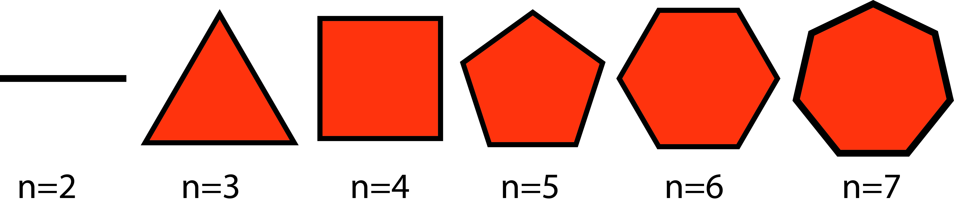
DEFINITON: A symmetry of an object in the plane is a rigid motion of the plane that leaves the object apparently unchanged.
DEFINITION: The regular n-sided polygon (also called the regular n-gon) is the shape in the plane enclosed by n equal-length straight sides, assembled so that all n of its angles are equal.
FIND THE PATTERN: How many rotation and reflection symmetries
does the regular n-gon have? What is its smallest non-zero rotation angle?

Slide 40
DEFINITON: A symmetry of an object in the plane is a rigid motion of the plane that leaves the object apparently unchanged.
DEFINITION: The regular n-sided polygon (also called the regular n-gon) is the shape in the plane enclosed by n equal-length straight sides, assembled so that all n of its angles are equal.
FIND THE PATTERN: How many rotation and reflection symmetries
does the regular n-gon have? What is its smallest non-zero rotation angle?
Answer: It has n rotations and n flips. The smallest angle is 360/n.

Slide 41
DEFINITON: A symmetry of an object in the plane is a rigid motion of the plane that leaves the object apparently unchanged.
DEFINITION: The regular n-sided polygon (also called the regular n-gon) is the shape in the plane enclosed by n equal-length straight sides, assembled so that all n of its angles are equal.
QUESTION: Can you think of an object that has infinitely many different
symmetries? How many such objects can you think of?

Slide 42
DEFINITON: A symmetry of an object in the plane is a rigid motion of the plane that leaves the object apparently unchanged.
This definition is central to the entire course!
Let’s see how this definition applies to other objects.
Each previous object was bounded (all of it fit on the screen).
An unbounded object could not entirely fit on any screen
(because it extends indefinitely up, down, right or left).
Next, we’ll study the symmetries of some unbounded objects…

Slide 43

DEFINITON: A symmetry of an object in the plane is a rigid motion of the plane that leaves the object apparently unchanged.
An indefinite extension to the right and left of a pattern like this
is called a border pattern.
Q: What symmetries does this border pattern have?

Slide 44

DEFINITON: A symmetry of an object in the plane is a rigid motion of the plane that leaves the object apparently unchanged.
An indefinite extension to the right and left of a pattern like this
is called a border pattern.
Q: What symmetries does this border pattern have?
A: It has…
(1) Translation symmetries (left or right any whole number of inches)
A translation means a shifting/sliding of the plane.
The direction and length of a translation can be
encoded by an arrow.

Slide 45
DEFINITON: A symmetry of an object in the plane is a rigid motion of the plane that leaves the object apparently unchanged.
An indefinite extension to the right and left of a pattern like this
is called a border pattern.
Q: What symmetries does this border pattern have?
A: It has…
(1) Translation symmetries (left or right any whole number of inches)
(2) Rotation symmetries (by 180 degrees about certain points)

Slide 46

DEFINITON: A symmetry of an object in the plane is a rigid motion of the plane that leaves the object apparently unchanged.
An indefinite extension to the right and left of a pattern like this
is called a border pattern.
Q: What symmetries does this border pattern have?
A: It has…
(1) Translation symmetries (left or right any whole number of inches)
(2) Rotation symmetries (by 180 degrees about certain points)
(3) Reflection symmetries (over certain vertical lines)

Slide 47
DEFINITON: A symmetry of an object in the plane is a rigid motion of the plane that leaves the object apparently unchanged.
An indefinite extension to the right and left of a pattern like this
is called a border pattern.
Q: What symmetries does this border pattern have?
A: It has…
(1) Translation symmetries (left or right any whole number of inches)
(2) Rotation symmetries (by 180 degrees about certain points)
(3) Reflection symmetries (over certain vertical lines)
(4) Reflection symmetries (over its horizontal center line)

Slide 48
DEFINITON: A symmetry of an object in the plane is a rigid motion of the plane that leaves the object apparently unchanged.
An indefinite extension to the right and left of a pattern like this
is called a border pattern.
Q: What symmetries does this border pattern have?
A: It has…
(1) Translation symmetries (left or right any whole number of inches)
(2) Rotation symmetries (by 180 degrees about certain points)
(3) Reflection symmetries (over certain vertical lines)
(4) Reflection symmetries (over its horizontal center line)
Performing any pair of symmetries in succession yields another symmetry.
For example, (1) followed by (4) yields a symmetry called a glide-reflection.

Slide 49
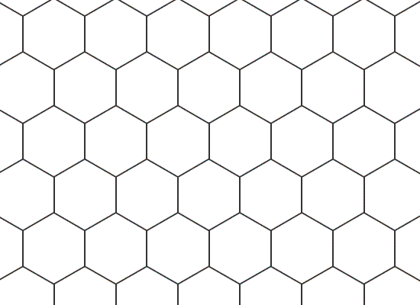
An indefinite extension to the right, left, up, and down of a pattern like this
is called a wallpaper pattern.
Q: What symmetries does this wallpaper pattern have?

Slide 50
An indefinite extension to the right, left, up, and down of a pattern like this
is called a wallpaper pattern.
Q: What symmetries does this wallpaper pattern have?
A: It has…
(1) Translation symmetries

Slide 51
An indefinite extension to the right, left, up, and down of a pattern like this
is called a wallpaper pattern.
Q: What symmetries does this wallpaper pattern have?
A: It has…
(1) Translation symmetries
(2) Rotation symmetries

Slide 52
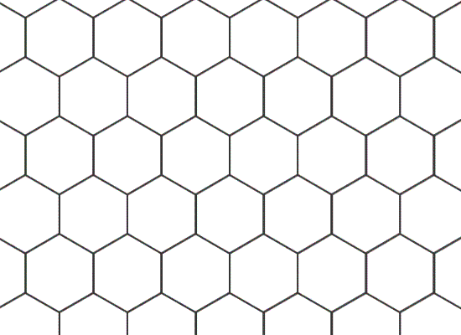
An indefinite extension to the right, left, up, and down of a pattern like this
is called a wallpaper pattern.
Q: What symmetries does this wallpaper pattern have?
A: It has…
(1) Translation symmetries
(2) Rotation symmetries
(3) Reflection symmetries

Slide 53
An indefinite extension to the right, left, up, and down of a pattern like this
is called a wallpaper pattern.
Q: What symmetries does this wallpaper pattern have?
Q: Can you characterize all of its rotation, translation and reflection symmetries?

Slide 54
Precise definitions
We require a more precise definition of…
“bounded” & “unbounded”
“border pattern” & “wallpaper pattern”
“glide reflection”
“rigid motion”

Slide 55
Precise definitions
How should we precisely define “bounded” and “unbounded”?
BOUNDED
UNBOUNDED

Slide 56
Precise definitions
DEFINITION: An object in the plane is called bounded if it is fully contained in some square in the plane. Otherwise it is called unbounded.
(Note: If you defined “unbounded” first, you’d use end up using phrases
like “extending indefinitely” or “extending to infinity” which is not very precise.)

Slide 57
Precise definitions
How should we define “border pattern” and “wallpaper pattern”?
BORDER PATTERN
WALLPAPER PATTERN

Slide 58
Precise definitions
DEFINITION: An unbounded object in the plane that has at least one translation symmetry (besides the identity) is called…
...a border pattern if all its translations are parallel to a single line.
…a wallpaper pattern otherwise.
(Note: Border and wallpaper patterns are defined here in terms of the types of
symmetries they have, not in terms of what they look like.)

Slide 59
Precise definitions
DEFINITION: An object in the plane is called bounded if it is fully contained in some square in the plane. Otherwise it is called unbounded.
DEFINITION: An unbounded object in the plane that has at least one translation symmetry (besides the identity) is called…
...a border pattern if all its translations are parallel to a single line.
…a wallpaper pattern otherwise.
(Note: Border and wallpaper patterns are defined here in terms of the types of
symmetries they have, not in terms of what they look like.)

Slide 60
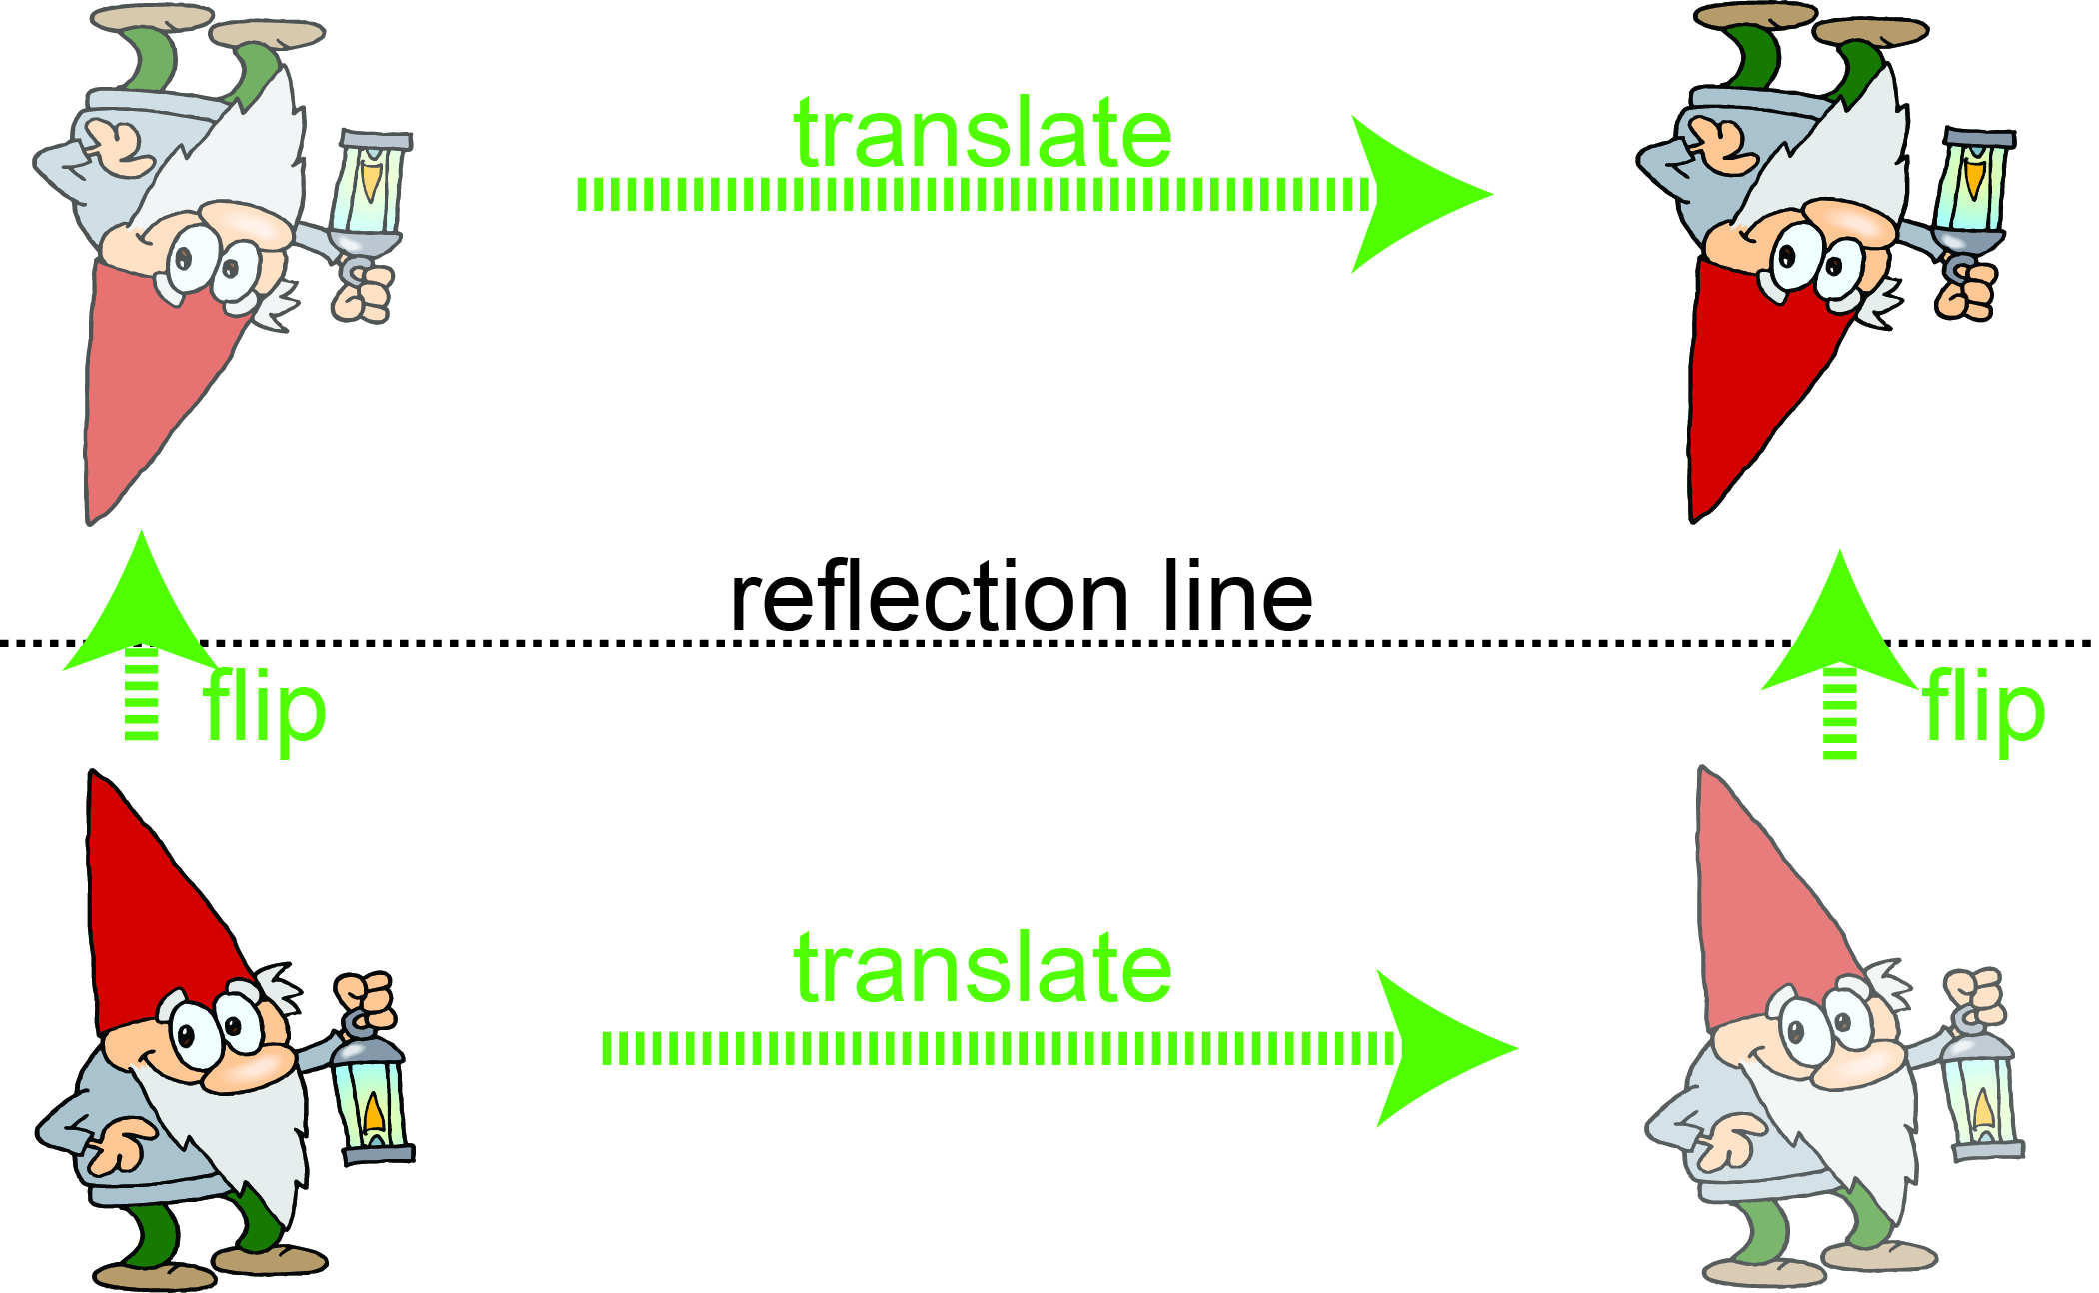
Precise definitions
DEFINITION: An object in the plane is called bounded if it is fully contained in some square in the plane. Otherwise it is called unbounded.
DEFINITION: An unbounded object in the plane that has at least one translation symmetry (besides the identity) is called…
...a border pattern if all its translations are parallel to a single line.
…a wallpaper pattern otherwise.
DEFINITION: A glide-reflection means the result of performing a translation (other than the identity) followed by a reflection over a line that is parallel to the direction of the translation.
(The other order would be the same thing.)

Slide 61
Precise definitions
DEFINITION: An object in the plane is called bounded if it is fully contained in some square in the plane. Otherwise it is called unbounded.
DEFINITION: An unbounded object in the plane that has at least one translation symmetry (besides the identity) is called…
...a border pattern if all its translations are parallel to a single line.
…a wallpaper pattern otherwise.
DEFINITION: A glide-reflection means the result of performing a translation (other than the identity) followed by a reflection over a line that is parallel to the direction of the translation.
DEFINITON: A symmetry of an object in the plane is a rigid motion of the plane that leaves the object apparently unchanged.
But what is a rigid motion?

Slide 62

What is a rigid motion?
INTUITIVELY: visualize “the plane” as an infinite glass wall. A rigid motion means
a moving/repositioning of the glass wall, like a rotation, translation or flip.
it may NOT break, bend, stretch, compress or otherwise
distort distances on the glass wall (you can’t use a glass cutter or a blow torch).

Slide 63
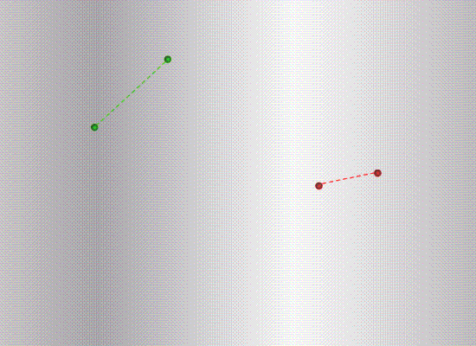
What is a rigid motion?
INTUITIVELY: visualize “the plane” as an infinite glass wall. A rigid motion means
a moving/repositioning of the glass wall, like a rotation, translation or flip.
it may NOT break, bend, stretch, compress or otherwise
distort distances on the glass wall (you can’t use a glass cutter or a blow torch).
KEY POINT: The distance between any pair of points is the same before and
after the rigid motion is applied.
(that’s why it’s called “rigid”)

Slide 64
What is a rigid motion?
INTUITIVELY: visualize “the plane” as an infinite glass wall. A rigid motion means
a moving/repositioning of the glass wall, like a rotation, translation or flip.
it may NOT break, bend, stretch, compress or otherwise
distort distances on the glass wall (you can’t use a glass cutter or a blow torch).
KEY POINT: The distance between any pair of points is the same before and
after the rigid motion is applied.
KEY POINT: Only the final effect of the rigid motion matters.
for example, a rotation by 90 degrees is the same as a rotation by 90+360 = 450
degrees about the same point.

Slide 65

What is a rigid motion?
INTUITIVELY: visualize “the plane” as an infinite glass wall. A rigid motion means
a moving/repositioning of the glass wall, like a rotation, translation or flip.
it may NOT break, bend, stretch, compress or otherwise
distort distances on the glass wall (you can’t use a glass cutter or a blow torch).
KEY POINT: The distance between any pair of points is the same before and
after the rigid motion is applied.
KEY POINT: Only the final effect of the rigid motion matters.
for example, a rotation by 90 degrees is the same as a rotation by 90+360 = 450
degrees about the same point. Here is another example:
The same
rigid motion

Slide 66
What is a rigid motion?
INTUITIVELY: visualize “the plane” as an infinite glass wall. A rigid motion means
a moving/repositioning of the glass wall, like a rotation, translation or flip.
it may NOT break, bend, stretch, compress or otherwise
distort distances on the glass wall (you can’t use a glass cutter or a blow torch).
KEY POINT: The distance between any pair of points is the same before and
after the rigid motion is applied.
KEY POINT: Only the final effect of the rigid motion matters.
for example, a rotation by 90 degrees is the same as a rotation by 90+360 = 450
degrees about the same point.
KEY POINT: A rigid motion is always a motion of the whole plane (the whole glass
wall); one may then ask whether it is a symmetry of any object in the plane.

Slide 67
What is a rigid motion?
INTUITIVELY: visualize “the plane” as an infinite glass wall.
Really the plane means the xy-plane – that is,
the set of all ordered pairs (x,y) of real numbers.

Slide 68
What is a rigid motion?
INTUITIVELY: visualize “the plane” as an infinite glass wall.
Really the plane means the xy-plane – that is,
the set of all ordered pairs (x,y) of real numbers.
When a rigid motion is applied to the plane,
any object in the plane moves along with the plane,
But the xy-coordinate axes DO NOT MOVE.

Slide 69
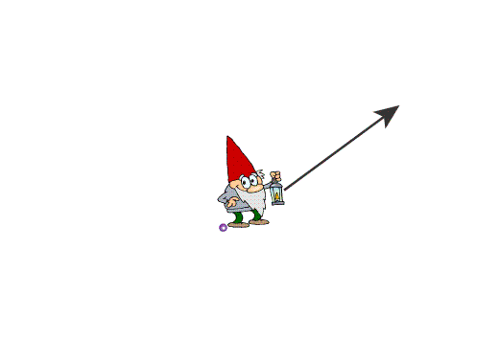
What is a rigid motion?
INTUITIVELY: visualize “the plane” as an infinite glass wall.
Really the plane means the xy-plane – that is,
the set of all ordered pairs (x,y) of real numbers.
When a rigid motion is applied to the plane,
any object in the plane moves along with the plane,
But the xy-coordinate axes DO NOT MOVE.
y
Here is a translation followed by
a rotation about the (purple) origin.
Notice that the origin does NOT translate.
x

Slide 70
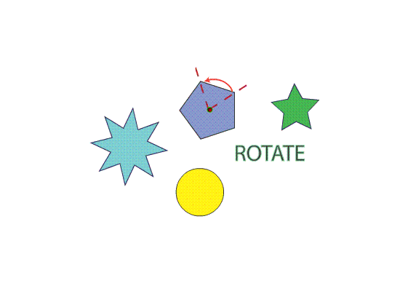
What is a rigid motion?
EXAMPLE: This 72 degree rotation is a rigid motion of the plane.
It is a symmetry of the purple pentagon, not of the other shapes.

Slide 71
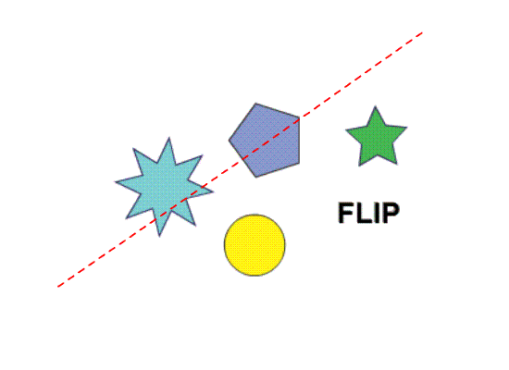
What is a rigid motion?
EXAMPLE: This reflection is a rigid motion of the plane.
It is a symmetry of the purple pentagon, but not of the other shapes.

Slide 72
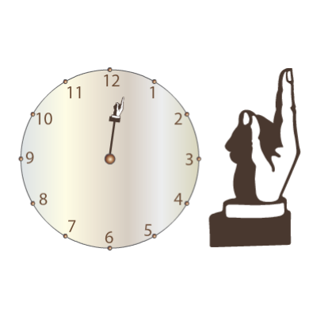
What is a rigid motion?
Imagine how a vertical flip will affect this clock and right hand…

Slide 73
What is a rigid motion?
Imagine how a vertical flip will affect this clock and right hand…
It becomes a counterclock!
(a clock that turns counterclockwise)
It becomes a left hand!

Slide 74
What is a rigid motion?
DEFINITION: A rigid motion is called proper if, after the motion is applied, an image of a right hand still looks like a right hand (or improper if it turns a right hand into a left hand).

Slide 75
What is a rigid motion?
DEFINITION: A rigid motion is called proper if, after the motion is applied, an image of a right hand still looks like a right hand (or improper if it turns a right hand into a left hand).
Rotations and translations are proper.
A flip is improper. A flip followed by a rotation or translation is also improper.

Slide 76
What is a rigid motion?
Types or rigid motions: rotations, translations, reflections,….any others?

Slide 77
What is a rigid motion?
Types or rigid motions: rotations, translations, reflections,….any others?
CLASSIFICATION OF PLANE RIGID MOTIONS (VERSION 1):
Every proper rigid motion of the plane is a translation, a rotation, or a rotation followed by a translation.
Every improper rigid motion of the plane is a flip, or a flip followed by a translation.

Slide 78
What is a rigid motion?
Types or rigid motions: rotations, translations, reflections,….any others?
CLASSIFICATION OF PLANE RIGID MOTIONS (VERSION 1):
Every proper rigid motion of the plane is a translation, a rotation, or a rotation followed by a translation.
Every improper rigid motion of the plane is a flip, or a flip followed by a translation.
For symmetries of bounded objects, the story might be simpler…

Slide 79
What is a rigid motion?
Types or rigid motions: rotations, translations, reflections,….any others?
CLASSIFICATION OF PLANE RIGID MOTIONS (VERSION 1):
Every proper rigid motion of the plane is a translation, a rotation, or a rotation followed by a translation.
Every improper rigid motion of the plane is a flip, or a flip followed by a translation.
For symmetries of bounded objects, the story might be simpler…
TRUE OR FALSE: If an object has any translation symmetries (other than
the identity) then it must be an unbounded object.

Slide 80
What is a rigid motion?
Types or rigid motions: rotations, translations, reflections,….any others?
CLASSIFICATION OF PLANE RIGID MOTIONS (VERSION 1):
Every proper rigid motion of the plane is a translation, a rotation, or a rotation followed by a translation.
Every improper rigid motion of the plane is a flip, or a flip followed by a translation.
For symmetries of bounded objects, the story might be simpler…
TRUE OR FALSE: If an object has any translation symmetries (other than
the identity) then it must be an unbounded object.

Slide 81
What is a rigid motion?
Types or rigid motions: rotations, translations, reflections,….any others?
CLASSIFICATION OF PLANE RIGID MOTIONS (VERSION 1):
Every proper rigid motion of the plane is a translation, a rotation, or a rotation followed by a translation.
Every improper rigid motion of the plane is a flip, or a flip followed by a translation.
For symmetries of bounded objects, the story might be simpler…
TRUE OR FALSE: If an object has any translation symmetries (other than
the identity) then it must be an unbounded object.
TRUE OR FALSE: A bounded object could never have any translation symmetries
other than the identity.

Slide 82
What is a rigid motion?
Types or rigid motions: rotations, translations, reflections,….any others?
CLASSIFICATION OF PLANE RIGID MOTIONS (VERSION 1):
Every proper rigid motion of the plane is a translation, a rotation, or a rotation followed by a translation.
Every improper rigid motion of the plane is a flip, or a flip followed by a translation.
For symmetries of bounded objects, the story might be simpler…
TRUE OR FALSE: If an object has any translation symmetries (other than
the identity) then it must be an unbounded object.
TRUE OR FALSE: A bounded object could never have any translation symmetries
other than the identity.

Slide 83
What is a rigid motion?
CLASSIFICATION OF PLANE RIGID MOTIONS (VERSION 1):
Every proper rigid motion of the plane is a translation, a rotation, or a rotation followed by a translation.
Every improper rigid motion of the plane is a flip, or a flip followed by a translation.
For symmetries of bounded objects, forget about translations…
THE CENTER POINT THEOREM: Any bounded object in the plane has a “center point” such that:
(1) Every proper symmetry is a rotation about this center point.
(2) Every improper symmetry is a flip over a line through this center point.

Slide 84
This pentagon has 5 rotation symmetries
and 5 reflection symmetries.
Can you orient it? That is, can you artistically change it
into an object with 5 rotation symmetries and NO reflection symmetries?

Slide 85
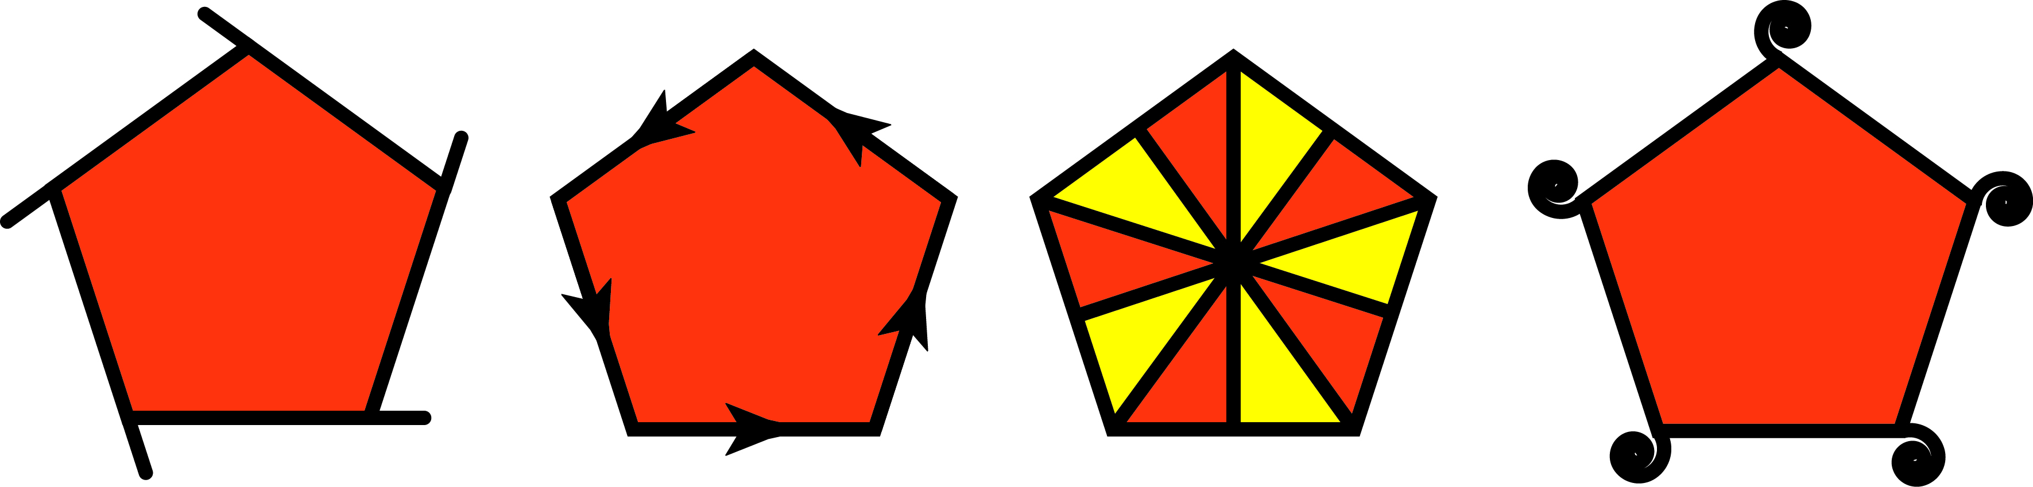
This pentagon has 5 rotation symmetries
and 5 reflection symmetries.
Can you orient it? That is, can you artistically change it
into an object with 5 rotation symmetries and NO reflection symmetries?
These are oriented pentagons
DEFINITION: An object in the plane is called oriented if it has NO improper symmetries.

Slide 86
Z Z Z Z Z Z Z Z Z Z Z Z Z Z Z Z Z
Is this border pattern oriented?
DEFINITION: An object in the plane is called oriented if it has NO improper symmetries.

Slide 87
Z Z Z Z Z Z Z Z Z Z Z Z Z Z Z Z Z
Is this border pattern oriented? YES!
DEFINITION: An object in the plane is called oriented if it has NO improper symmetries.

Slide 88
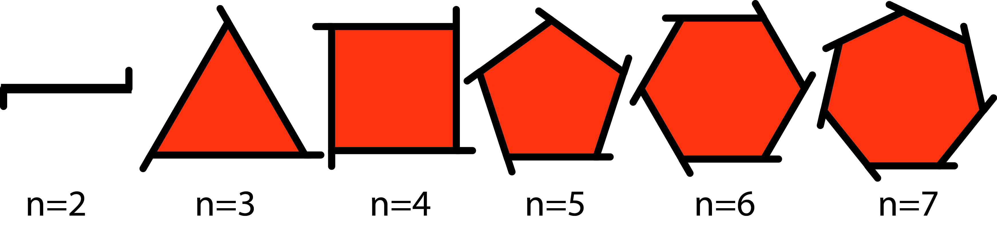
Z Z Z Z Z Z Z Z Z Z Z Z Z Z Z Z Z
Is this border pattern oriented?
Is this border pattern oriented? YES!
These are oriented polygons
DEFINITION: An object in the plane is called oriented if it has NO improper symmetries.

Slide 89
Z Z Z Z Z Z Z Z Z Z Z Z Z Z Z Z Z
Is this border pattern oriented?
Is this border pattern oriented? YES!
These are oriented polygons
For bounded objects, “oriented” = “flipless”
DEFINITION: An object in the plane is called oriented if it has NO improper symmetries.

Slide 90

Is this border pattern oriented?
For bounded objects, “oriented” = “flipless”
DEFINITION: An object in the plane is called oriented if it has NO improper symmetries.

Slide 91
Is this border pattern oriented?
NO, it has improper symmetries (namely, glide reflections)
For bounded objects, “oriented” = “flipless”
DEFINITION: An object in the plane is called oriented if it has NO improper symmetries.

Slide 92

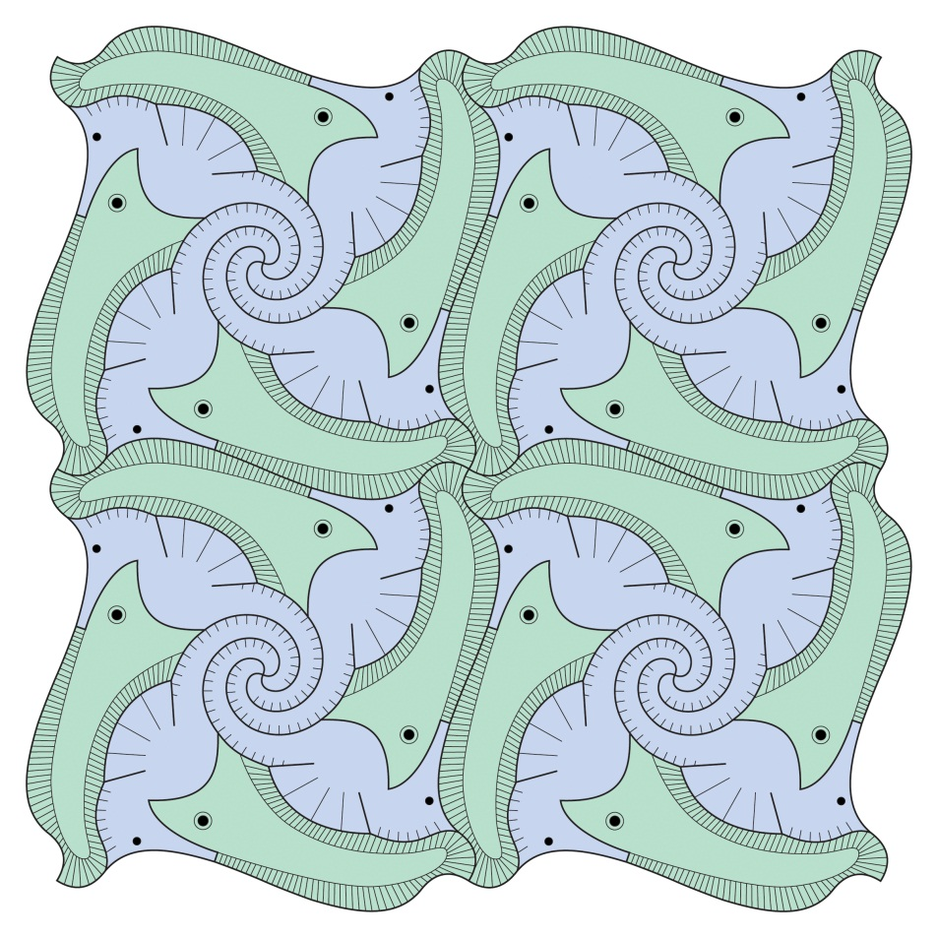

Which are oriented?

Slide 93
Vocabulary Review
Symmetry
Rigid motion
Translation
Reflection/Flip
Oriented
Border pattern
Wallpaper pattern
Identity
n-gon
Oriented n-gon
Bounded
Unbounded
Glide-reflection
Proper
Improper
Asymmetric
Theorem Review
The Classification of Plane Rigid Motions
The Center Point Theorem

